Slide 1
A Survey on Rain Removal from Video and Single Image
Hong Wang, Minghan Li, Yichen Wu, Qian Zhao, and Deyu Meng, Member, IEEE
Notes:
第一页

Slide 2
Abstract
in this study we present a comprehensive review for current rain removal methods for video and a single image.
Notes:
第二页

Slide 3
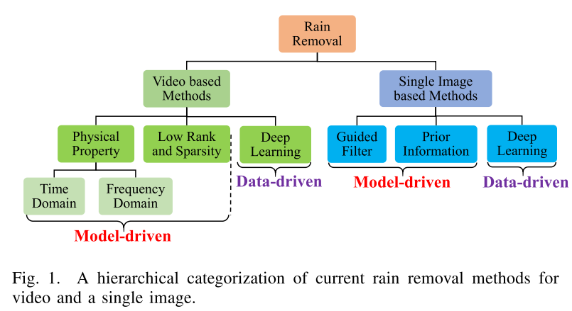
Introduction
conventional methods mainly adopt the model-driven methodology and especially focus on sufficiently utilizing and encoding physical properties of rain and prior knowledge of background scenes into an optimization problem and designing rational algorithms to solve it
data-driven manner by designing specific network architectures and pre-collecting rainy-clean image pairs to learn network parameters to attain complex rain removal functions

Slide 4
we summarize the physical properties of rain commonly used for rain modeling by previous research.
we provide a comprehensive performance on representative rain removal methods and evaluate their respective capacity, especially generalization capability, both visually and quantitatively.
we release a comprehensive repository to facilitate an easy usage and performance reproduction/comparison of current rain removal methods for general users.

Slide 5
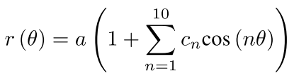

Review of current rain removal methods
Physical Properties of Rain
1.Geometirc property:sphere,radius is relate with direction θ and undistorted sphere a.
The relationship between the terminal velocity v (m/s) of a raindrop and its diameter d (mm) as:
ρ is the air density

Slide 6

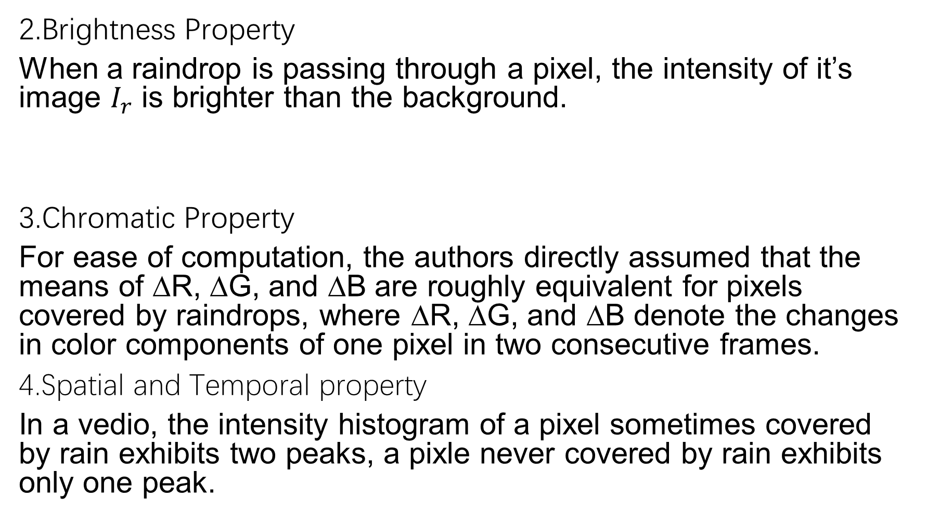
2.Brightness Property
When a raindrop is passing through a pixel, the intensity of it’s image $I_{r}$ is brighter than the background.
3.Chromatic Property
For ease of computation, the authors directly assumed that the means of ∆R, ∆G, and ∆B are roughly equivalent for pixels covered by raindrops, where ∆R, ∆G, and ∆B denote the changes in color components of one pixel in two consecutive frames.
4.Spatial and Temporal property
In a vedio, the intensity histogram of a pixel sometimes covered by rain exhibits two peaks, a pixle never covered by rain exhibits only one peak.

Slide 7
C.Single image rain removal methods
1.Filter based methods
2.Prior based Methods:????
3.Deep learning based methods:
R. Qian, R. Tan, W. Yang, J. Su, and J. Liu, “Attentive generative adversarial network for raindrop removal from a single image,” IEEE Conf. on Comput. Vision and Pattern Recognition, pp. 1-1, 2018.
X. Fu, J. Huang, and X. Ding, “Clearing the skies: a deep network architecture for single-image rain streaks removal,” IEEE Trans. on Image Process., vol. 1, no. 1, pp. 99, 2017.
X. Fu, J. Huang, D. Zeng, Y. Huang, X. Ding, and J. Paisley, “Removing rain from single images via a deep detail network,” IEEE Conf. on Comput. Vision and Pattern Recognition, pp. 1715-1723, 2017.
Z. Fan, H. Wu, X. Fu, Y. Huang, and X. Ding, “Residual guide feature fusion network for single image deraining,” In ACM Multimedia, 2018.
H. Zhang, V. Sindagi, and V. M. Patel, “Image de-raining using a conditional generative adversarial network,” IEEE Trans. on Circuits and Syst. for Video Technology, 2019.
H. Zhang and V. M. Patel, “Density-aware single image de-raining using a multi-stream dense network,” IEEE Conf. on Comput. Vision and Pattern Recognition, pp. 1-10, 2018.
W. Yang, R. Tan, J. Feng, J. Liu, Z. Guo, and S. Yan, “Deep joint raindetection and removal from a single image,” IEEE Conf. on Comput.Vision and Pattern Recognition, pp. 1685-1694, 2017.
F. Yu and V. Koltun, “Multi-scale context aggregation by dilated convolutions,” In Int. Conf. on Learning Representation, 2016.
H. Zhang and V. M. Patel, “Convolutional sparse and low-rank codingbased rain streak removal,” in Proc. of IEEE Winter Conf. on Applications of Comput. Vision, pp. 1259-1267, 2017.
X. Li, J. Wu, Z. Lin, H. Liu, and H. Zha, “Recurrent squeeze- and-excitation context aggregation net for single image deraining,” In European Conf. on Comput. Vision, pp. 262-277, 2018.

Slide 8
Y. Wang, X. Zhao, T. Jiang, L. Deng, Y. Chang, and T. Huang,“Rain streak removal for single image via kernel guided cnn,”arXiv:1808.08545, 2018.
J. Pan, S. Liu, J. Zhang, Y. Liu, J. Ren, and Zechao Li, “Learning dual convolutional neural networks for low-level vision,” IEEE Conf. on Comput. Vision and Pattern Recognition, pp. 1-10, 2018.
G. Li, X. He, W. Zhang, H. Chang, L. Dong, and L. Lin, “Non-locally
enhanced encoder-decoder network for single image de-raining,” In 2018 ACM Multimedia Conf. on Multimedia Conf., pp. 1056-1064, 2018.
D. Ren, W. Zuo, Q. Hu, P. Zhu, and D. Meng, “Progressive image deraining networks: a better and simpler baseline,” IEEE Conf. on
Comput. Vision and Pattern Recognition, 2019.
[71] T. Wang, X. Yang, K. Xu, S. Chen, Q. Zhang, and R. W. H. Lau,
“Spatial attentive single-image deraining with a high quality real rain
dataset,” IEEE Conf. on Comput. Vision and Pattern Recognition, 2019.

Slide 9
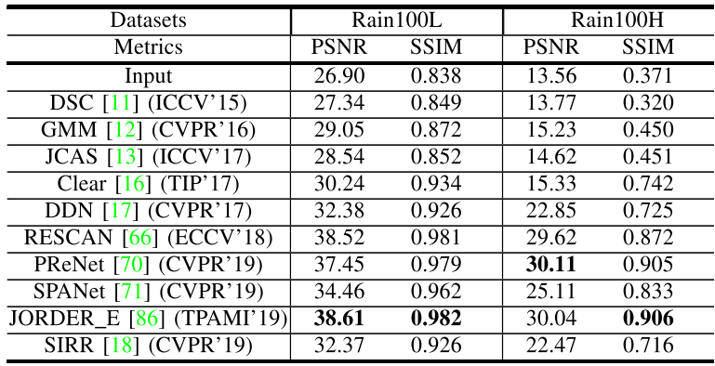
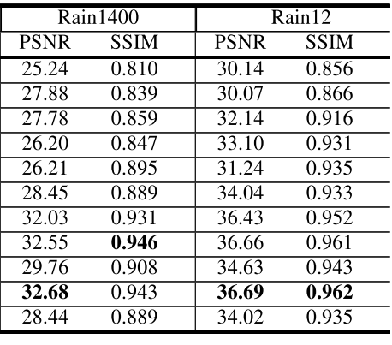
Experiments and analysis
B.Single Image Deraining Experiments
1.Synthetic Data:
Dataset | Rain1400 | Rain100L | Rain100H | Rain12
Total | 14000 | 300 | 1900 | 12
Rain Types | 14 | 1 | 5
Train:Test | 9:1 | 2:1 | 18:1

Slide 10
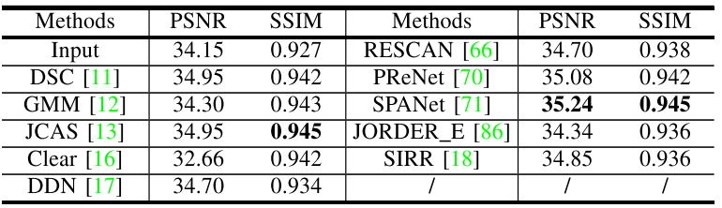
2 Real World Data
Internet-Data(no ground truth),SPA-Data(1000 images)
Perform at SPA-Data:

Slide 11
Conclusion and future works
Limitations:
1.Most of deraining methods tend to more or less remove texture details in rain-free regions.
2.mist/fog effect formed by rain streak accumulation.
3.Involving many iterations of computation.
Future directions:
Combining model-driven and data-driven into a unique framework
Transfer learning regimes
Online rain removal techniques with persistence,fast and universality

